Slide 1

Tensor Decomposition for Sub-typing of Complex Diseases based on Clinical and Genomic Data
Diana Diaz, Aliccia Bollig-Fischer, Alexander Kotov
Notes:
Thank you for being here, My name is Diana Diaz, I am a PhD student at Wayne State University, my advisor is Prof. Alexander Kotov and it is my pleasure to present our work entitled “Tensor Decomposition for Sub-typing of Complex Diseases based on Clinical and Genomic Data“, in collaboration with Dr. Aliccia Bollig-Fisher

Slide 2
Disease subtyping
Notes:
Traditional medicine is physicians apply the same treatment to all the patients that have diagnosed with the same disease, but precision medicine is when we would like to apply a treatment to each patient individualy, and stratified medicine is kind of a compromise in which we want to apply the same treatment to a group of patients.
One important step towards precision medicine is stratified medicine, which relies on disease subtyping to stratify patients in meaningful groups.
In this step, patients can grouped by:
Disease
Demographics
Clinical Features
Molecular Biomarkers, or
Subtypes

Slide 3

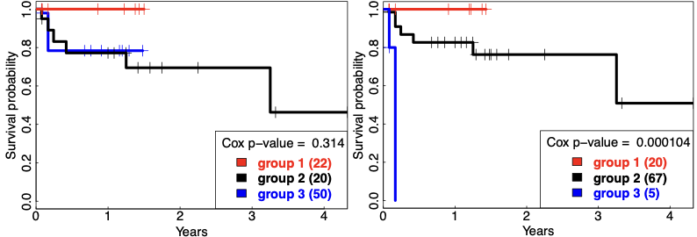
Disease subtyping
Input:
Data from individuals with a particular disease
Output:
Individuals clustered on clinically meaningful groups
Notes:
In disease subtyping we aim to find groups of patients that have similar characteristics or outcome, so we can offer close to personalized treatments.
In ML we are familiar with clustering techniques, but the big questions here are what data should we consider and how do we know that the partitions that we obtained are relevant?
To answer the second question, we considered partitions as being relevant if the ultimate groups are significantly different in terms of survival.

Slide 4
Disease subtyping
?
DATA INTEGRATION
Notes:
Now we still do not know. What data to analyze? Or which patient data is relevant to determine the best partition of patients in terms of survival?
And there is a lot of information to consider for each patient.
Genetic data has many genomics views
Clinical data is abundant, but typically unstructured
and other environmental factors that can be determined with wearables and other sources of data.
One approach that is getting some traction is to integrate some of these different sources of patient data. The hypothesis behind integrative approaches is that these different sources are complementary and can offer a more comprehensive view of diseases and cellular systems.
Effectively integrating multiple omics and patient data remains an open problem to date.

Slide 5
CLIGEN: unsupervised approach for disease subtyping based on CLInical and GENetic data
Clinical data
CLIGEN
Somatic mutations
disease
subtypes
Notes:
Here we proposed CLIGEN, a method to integrate Clinical data and Somatic Mutations for disease subtyping. The input of our method consist of two tables one the clinical data and somatic mutations

Slide 6
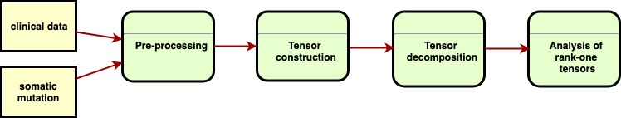
CLIGEN
Notes:
The overall pipeline consists of

Slide 7
Preprocessing and tensor construction

Slide 8
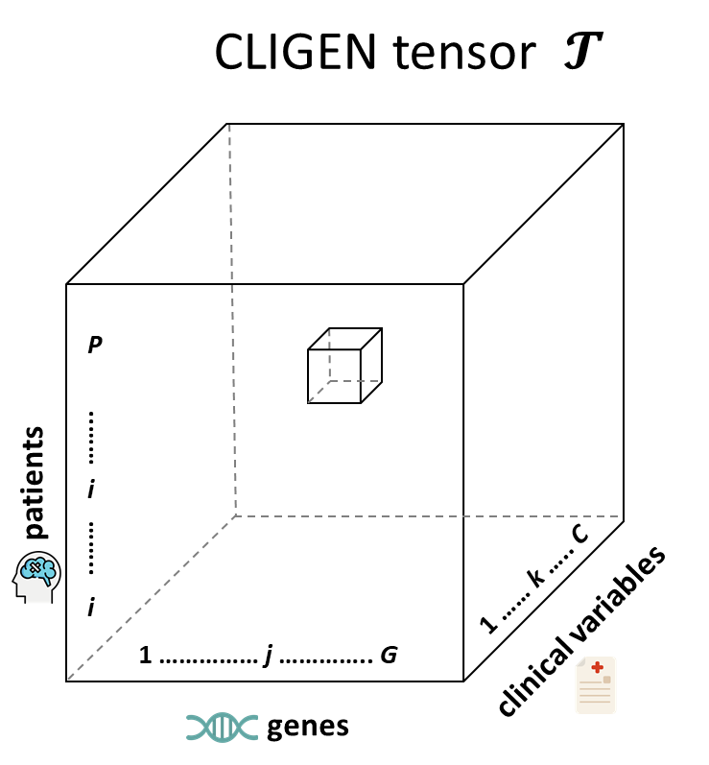
patient i has a mutation in gene j and kth value of clinical variables
1
0
patient i has no mutation in gene j or kth value of clinical variables

Slide 9
CP tensor decomposition
Notes:
The main idea behind tensor decomposition is that we can express a tensor as the sum of meaningful parts.
The building blocks for decomposition will be rank one tensors that are nothing more than vector outer products.
Using the three-way package in R

Slide 10

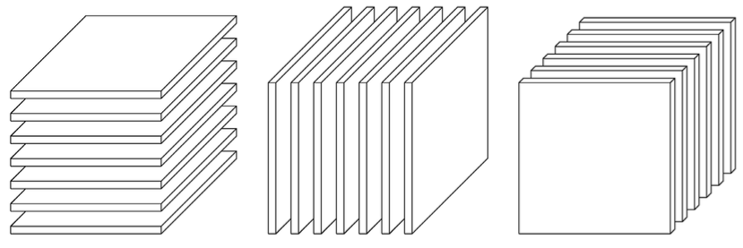


Tensor slices
Patient slices
Gene slices
Clinical slices
Image from: Kolda T, Bader B. Tensor decomposition and applications. SIAM review. 2009.

Slide 11


Dataset
Rank = 10
Notes:
M = 92, and the number of genes is N = 17,814.
184 signaling pathways
TCGA now moved to GDC (Genomic Data Commons Data Portal)

Slide 12

Dataset
Somatic mutations
Only non-silent mutations considered:
missense mutation
nonsense mutation
non-stop mutation
in-frame insertion
in-frame deletion
frameshift mutation
Notes:
M = 92, and the number of genes is N = 17,814.
184 signaling pathways

Slide 13
Dataset
Clinical variables
age at initial pathology diagnosis
gender
cancer stage
lymph node status
metastasis status
HER2 status
PR status
ER status
PAM50
Notes:
M = 92, and the number of genes is N = 17,814.
184 signaling pathways

Slide 14
Evaluation
Quantitative:
Cox model using subtypes as covariates to predict survival of breast cancer patients
Qualitative:
comparison of automatically derived subtypes with known breast cancer subtypes

Slide 15
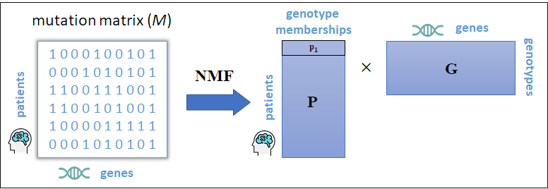
Obtaining genotypes through non-negative factorization of mutation matrix
Hofree M, Shen JP, Carter H, et al. Network-based stratification of tumor mutations. Nat Methods. 2013.
Notes:
We are not smoothing the binary matrix

Slide 16
Quantitative evaluation
NMF-based molecular subtypes
CLIGEN
NMF-based clinical subtypes

Slide 17
high
mutation
load
HER2+
ER+

Slide 18
triple-negative
breast cancer
subtype
PR+
ER+

Slide 19
Conclusions and future work
tensor factorization is a powerful tool that can be used to derive multimodal sub-types from different types of patient data (e.g. clinical and genomic)
we applied the proposed method to derive multimodal sub-types of BRCA patients and obtained clinically meaningful sub-types with significantly different survival rates.
Further improvements can be made by incorporating additional ‘omics’ data, such as gene expression.

Slide 20

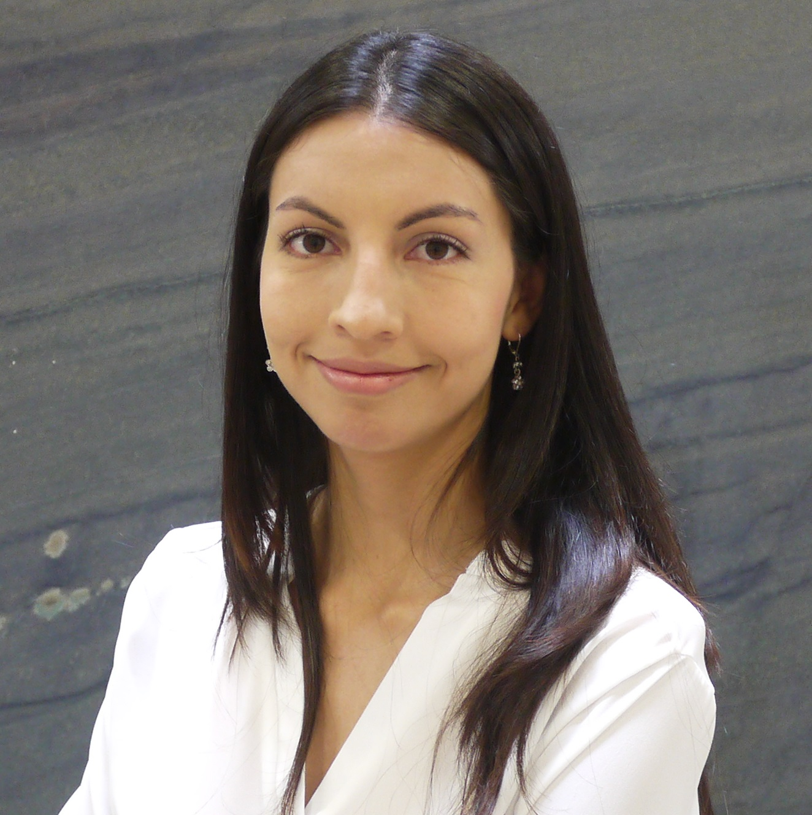
Thanks!
Diana Diaz
dmd@wayne.edu
www.cs.wayne.edu/dmd
Notes:
Thanks for attending my presentation.
I will be happy to address any questions.

